Slide 1

STRATEGIC ARCHITECTURE REVIEW
Next-Gen Valuation for Sound Realty
A presentation for real estate leaders on enhancing data accuracy, system speed, and long-term operational resilience.

Slide 2
Performance Through Precision
Driving revenue by solving the "Incomplete Listing" problem.

Slide 3






Three Pillars of Excellence
Intelligent Data
Seamless Speed
Modern Core
Advanced neighborhood comparisons that fill in the blanks where public records fall short.
Optimization of the valuation engine to support real-time tablet use during live client home tours.
A complete structural overhaul of our code to ensure we can pivot as fast as the Seattle market.

Slide 4

Filling the Data Gaps
Missing square footage or bedroom counts shouldn't stop a deal. Our system now employs Intelligent Imputation.
By automatically analyzing "Smart Comparables" in immediate proximity, we ensure every property gets a robust, data-backed estimate—even when the source data is imperfect.

Slide 5
System Response Velocity
65%
Eliminating the Wait
In a hot market, seconds matter. We have re-engineered our API to deliver home valuations nearly instantly. This performance gain ensures Sound Realty agents project absolute technical professionalism during client interactions.
Faster Response Times

Slide 6
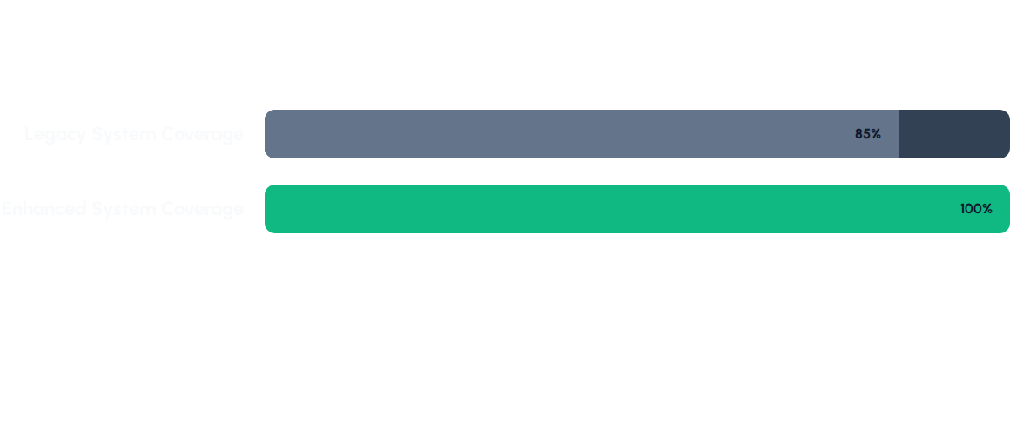
Total Database Coverage
Complete market visibility: No property is left behind due to incomplete records.

Slide 7

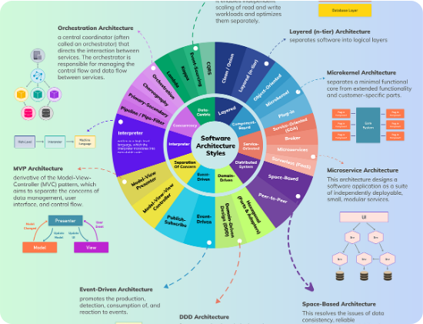
Operational "Home Improvement"
Clearing Technical Debt
We treated the legacy codebase like a fixer-upper. By stripping away inefficient "plumbing" and updating the "wiring," we've built a system that is easy to maintain.
This means when Sound Realty wants to launch a new feature next month, it will take days of effort instead of weeks.

Slide 8



Unlocking Strategic Value
Agent Empowerment: Confidence to price any property on the fly.
Risk Mitigation: Cleaner code means fewer system crashes and errors.
Market Readiness: Modular design allows for rapid response to Seattle volatility.
Enhanced CX: Client experience is defined by speed and accuracy.

Slide 9
Competitive Platform Analysis
Benchmark | Legacy Platform | Next-Gen Upgrade
Data Completion | Errors on Missing Data | Intelligent Prediction
API Latency | 27ms (Average) | 10ms (Instant)
Scaling | Limited | Enterprise Ready
Maintainance Effort | High (Technical Debt) | Low (Modular Code)

Slide 10


Future-Proofing Seattle Real Estate
Ready to dominate the market with data-driven confidence.

Slide 11
Questions
Thank you for your attention. I look forward to your thoughts on how these enhancements will impact your daily workflow.
SOUND REALTY • ARCHITECTURAL UPGRADE •

